Slide 1
St. Louis Central Corridor West Building Permits
Monthly Report: June 2021

Slide 2
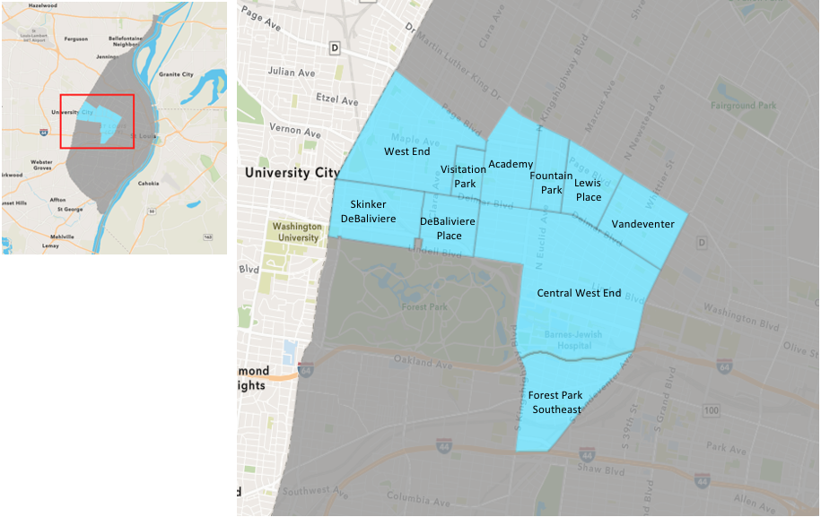
St. Louis Neighborhood Spatial Reference

Slide 3
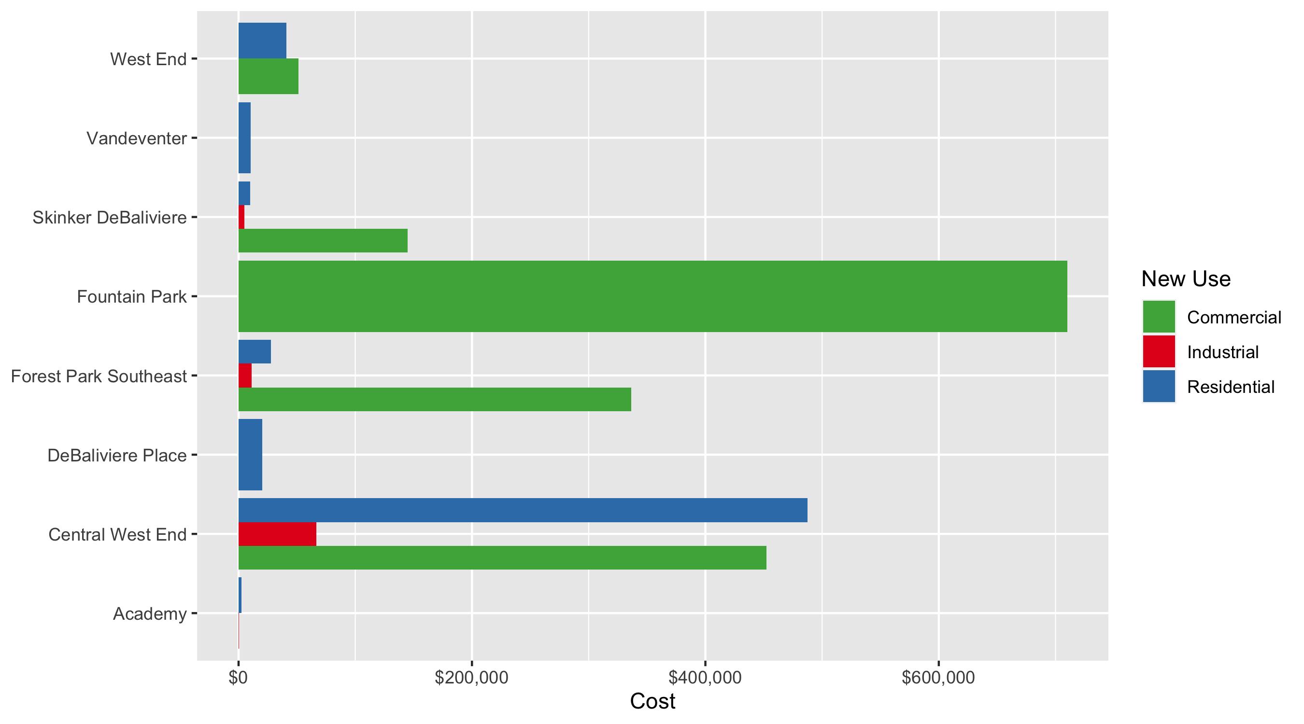
Neighborhood Summary: Average Building Permit Cost

Slide 4
Neighborhood Summary
June 2021 | June 2021 | June 2021 | June 2021
Neighborhood | Average Cost | # of Permits | Total Value of Permits
Academy | $1,464.50 | 4 | $5,858
Central West End | $421,957.67 | 30 | $12,658,730
DeBaliviere Place | $20,380.00 | 2 | $40,760
Forest Park Southeast | $116,537.06 | 17 | $1,981,130
Fountain Park | $710,000.00 | 1 | $710,000
Lewis Place | $0.00 | 0 | $0
Skinker DeBaliviere | $28,412.00 | 7 | $198,884
Vandeventer | $10,500.00 | 2 | $21,000
Visitation Park | $0.00 | 0 | $0
West End | $46,366.28 | 25 | $1,159,157
Last 6 Months | Last 6 Months | Last 6 Months | Last 6 Months
Neighborhood | Average Cost | # of Permits | Total Value of Permits
Academy | $46,885.86 | 50 | $2,344,293
Central West End | $717,716.78 | 601 | $431,347,786
DeBaliviere Place | $210,861.48 | 74 | $15,603,749
Forest Park Southeast | $416,782.84 | 207 | $86,274,047
Fountain Park | $240,376.06 | 16 | $3,846,017
Lewis Place | $23,055.52 | 21 | $484,166
Skinker DeBaliviere | $415,202.43 | 164 | $68,093,198
Vandeventer | $38,160.47 | 19 | $725,049
Visitation Park | $16,747.00 | 7 | $117,229
West End | $242,484.58 | 153 | $37,100,140

Slide 5
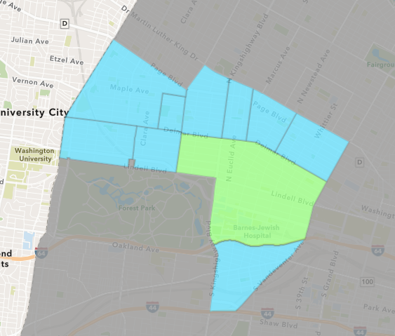
Central West End
June 2021 Neighborhood Cost Breakdown
Mean: $421,958
Median: $39,500
Range: $2,500 - $8,000,000

Slide 6
Central West End: Summary Notes
30 building permits in June 2021
-18.92% change compared to June 2020 (37 total building permits)
$421,958: Average building permit cost in June 2021
529.09% change compared to June 2020 ($67,074)
218 total building permits in 2021
19.13% change YTD compared to this time in 2020 (183 total building permits)
$1,325,645: YTD average building permit cost in 2021
336.84% change YTD compared to this time in 2020 ($303,462)

Slide 7
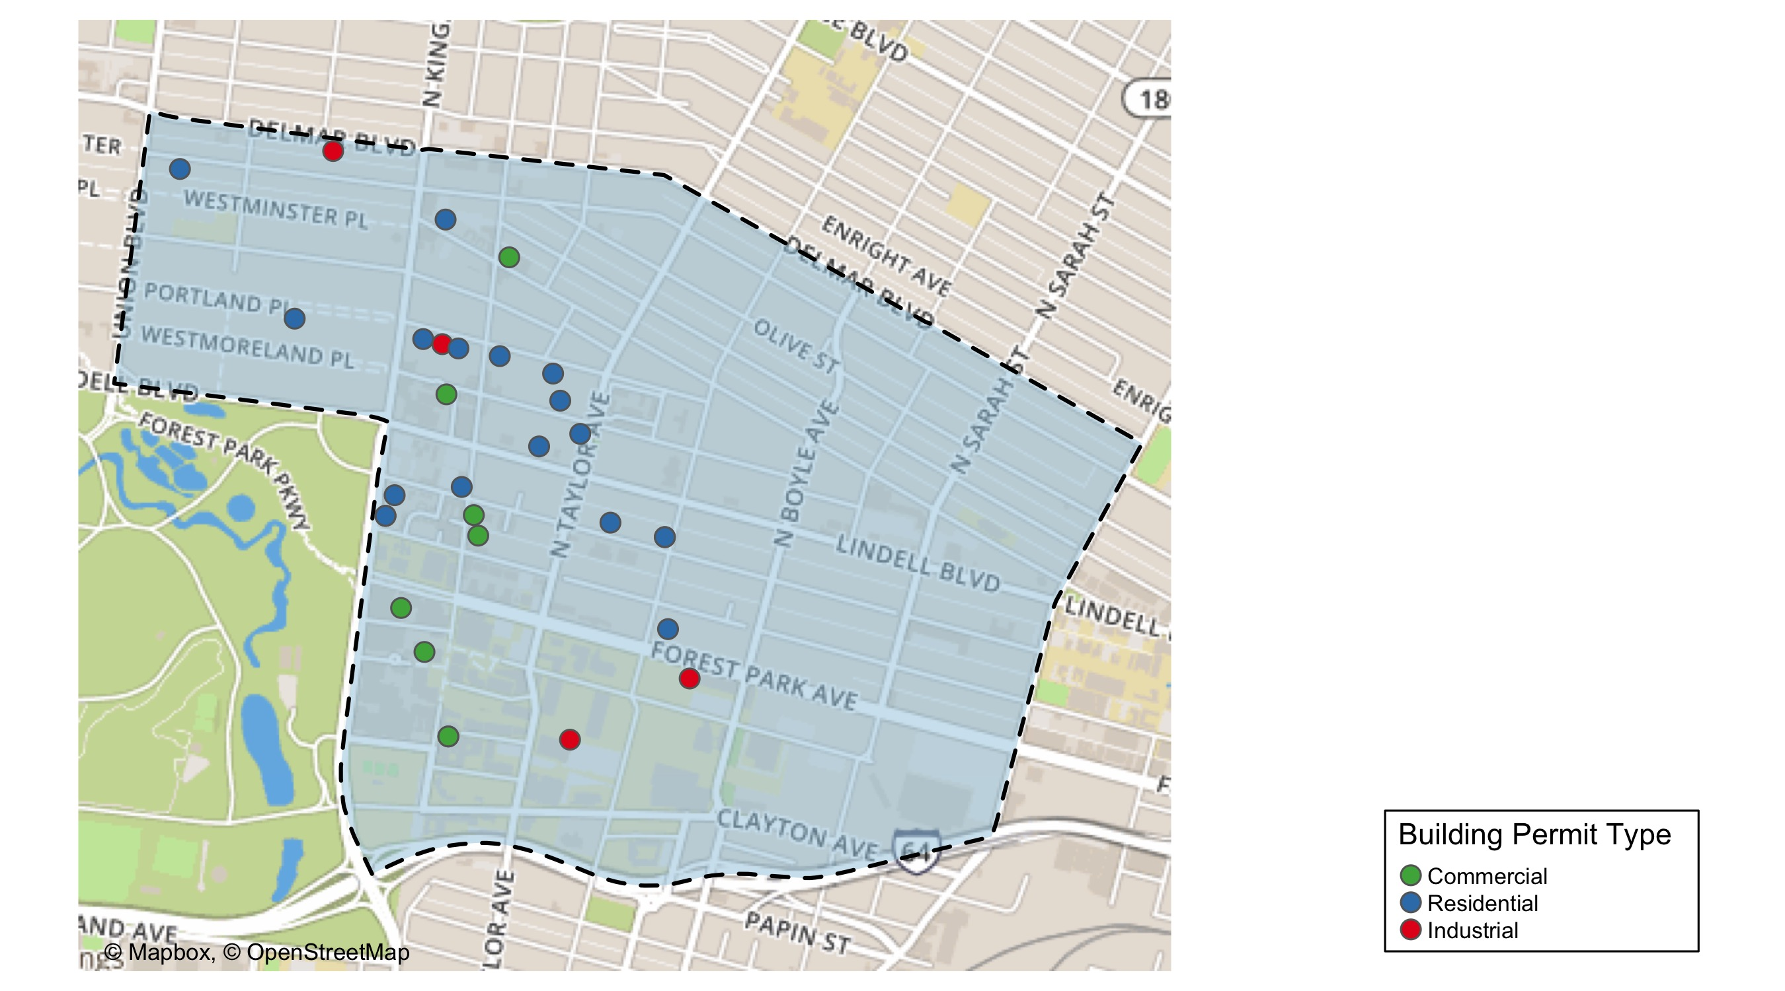
Central West End

Slide 8
Neighborhood Summary
June 2021 | June 2021 | June 2021 | June 2021
Permit Use | Average Cost | # of Permits | Total Value of Permits
Commercial | $452,468.0 | 8 | $3,619,744
Industrial | $66,750.0 | 4 | $267,000
Residential | $487,332.6 | 18 | $8,771,986
Last 6 Months | Last 6 Months | Last 6 Months | Last 6 Months
Permit Use | Average Cost | # of Permits | Total Value of Permits
Commercial | $1,233,775.0 | 273 | $336,820,576
Industrial | $1,226,399.4 | 29 | $35,565,583
Residential | $197,196.1 | 299 | $58,961,627

Slide 9
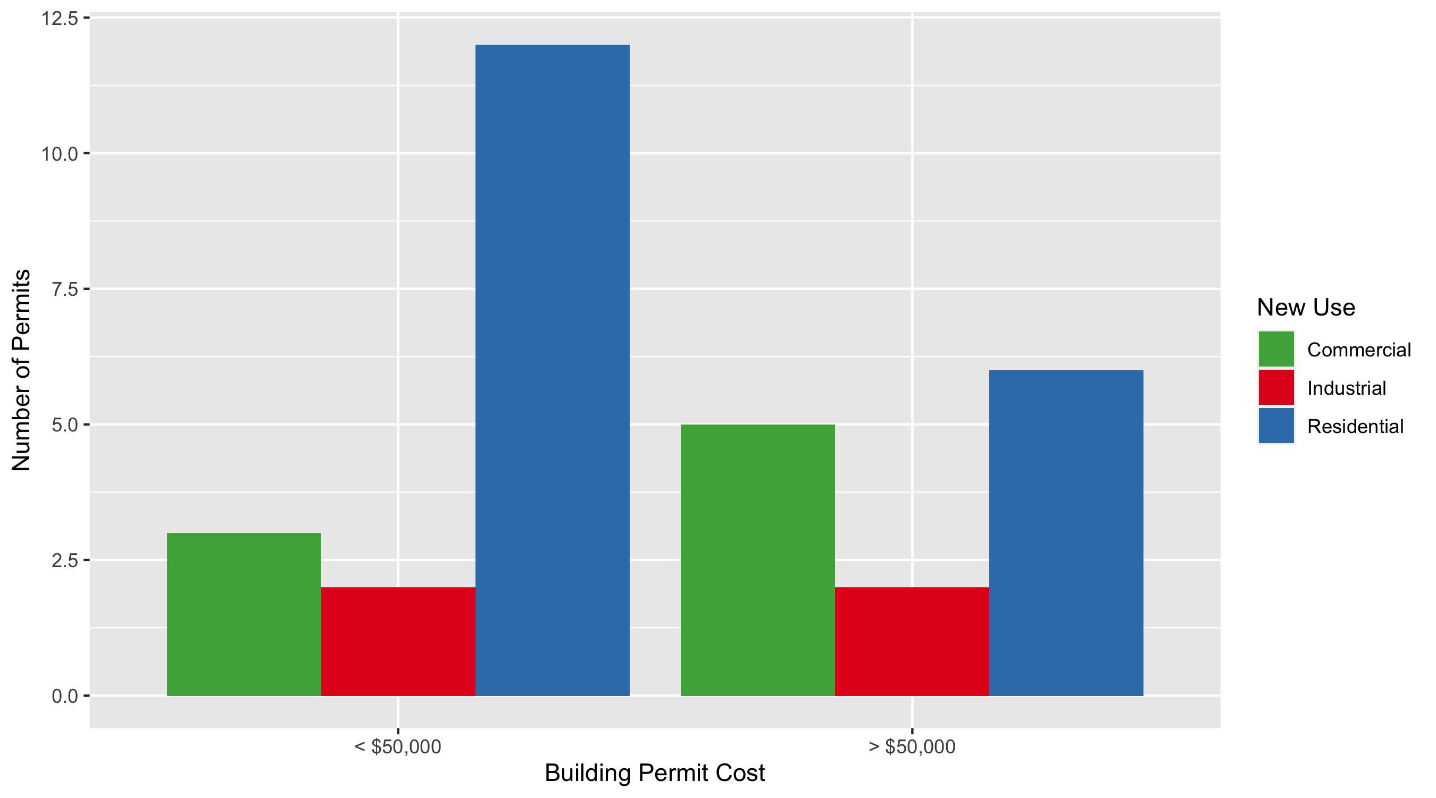
Central West End Permit Cost Breakdown

Slide 10
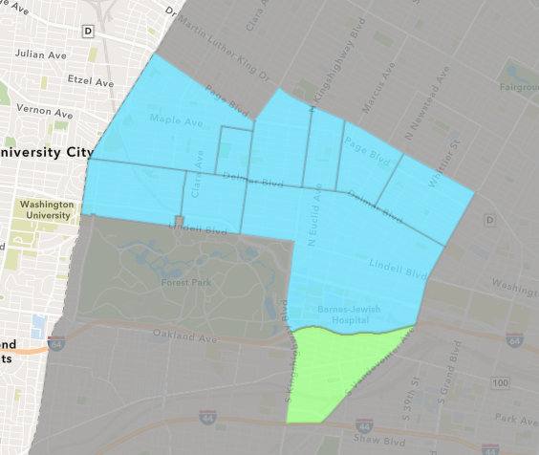
Forest Park Southeast
June 2021 Neighborhood Cost Breakdown
Mean: $116,537
Median: $10,000
Range: $500 - $1,149,737

Slide 11
Forest Park Southeast: Summary Notes
17 building permits in June 2021
21.43% change compared to June 2020 (14 total building permits)
$116,537: Average building permit cost in June 2021
-16.71% change compared to June 2020 ($139,925)
86 total building permits in 2021
43.33% change YTD compared to this time in 2020 (60 total building permits)
$688,605: YTD average building permit cost in 2021
169.58% change YTD compared to this time in 2020 ($255,436)

Slide 12
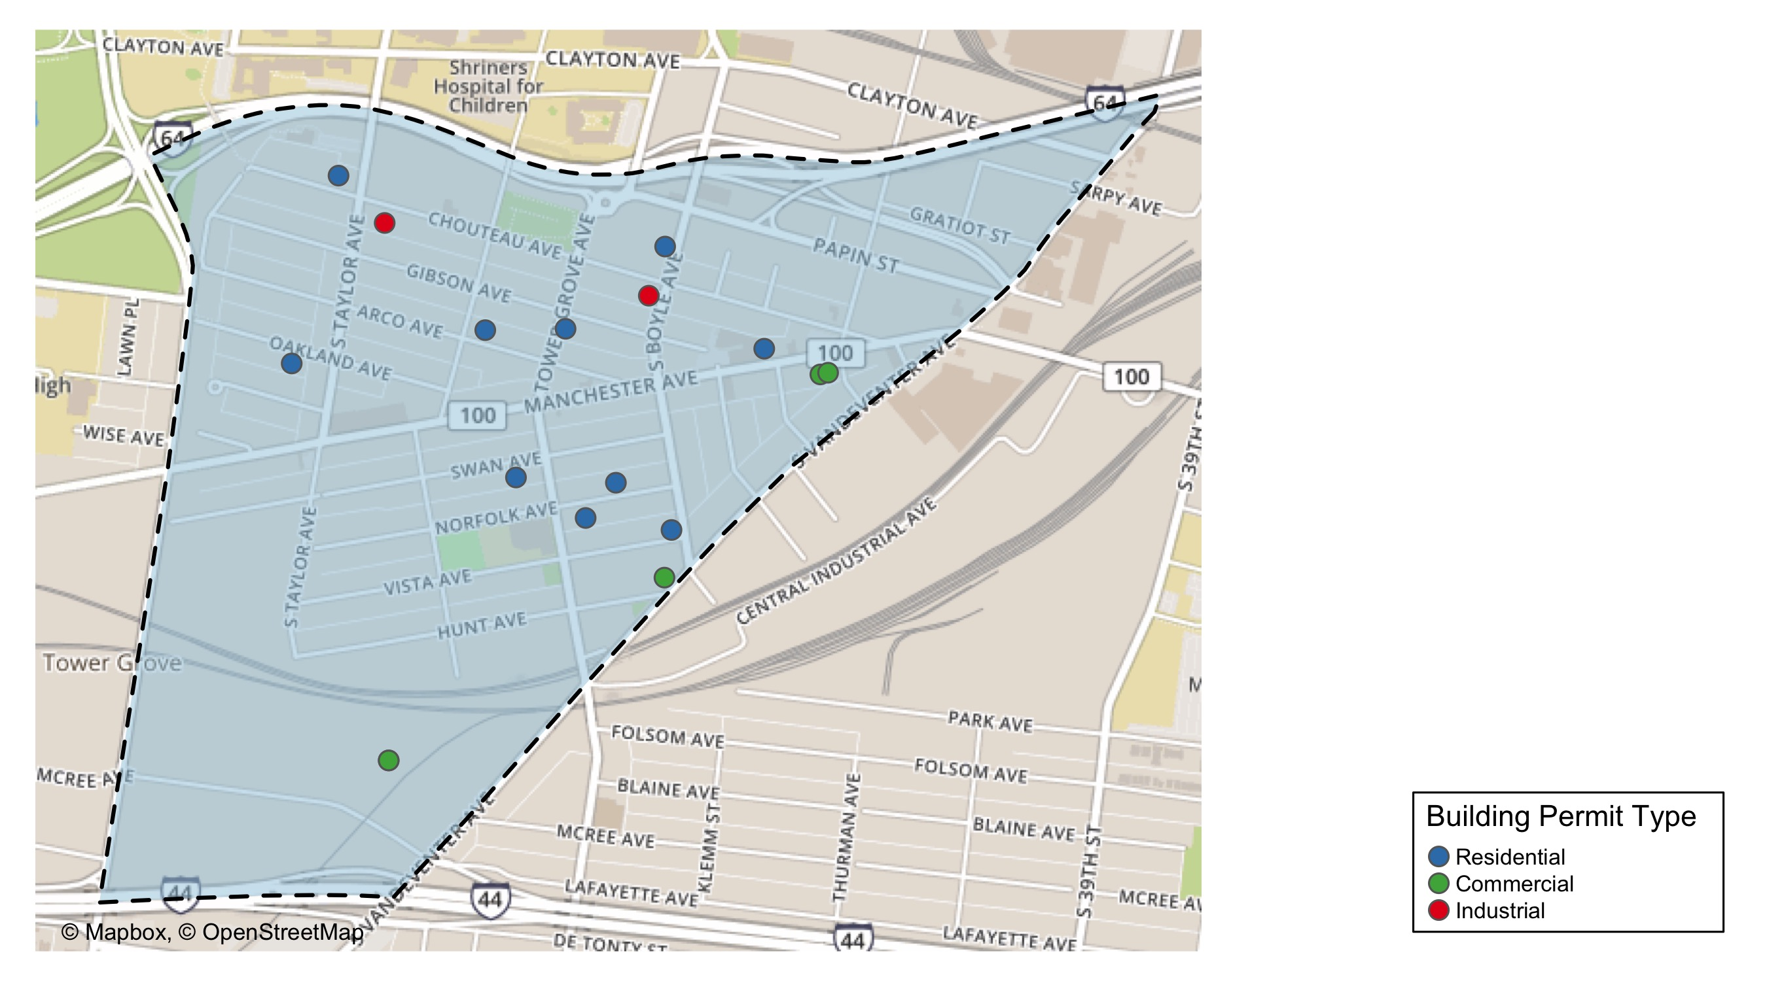
Forest Park Southeast

Slide 13
Neighborhood Summary
June 2021 | June 2021 | June 2021 | June 2021
Permit Use | Average Cost | # of Permits | Total Value of Permits
Commercial | $336,354 | 5 | $1,681,770
Industrial | $11,000 | 2 | $22,000
Residential | $27,736 | 10 | $277,360
Last 6 Months | Last 6 Months | Last 6 Months | Last 6 Months
Permit Use | Average Cost | # of Permits | Total Value of Permits
Commercial | $456,370.82 | 57 | $26,013,137
Industrial | $63,766.67 | 15 | $956,500
Residential | $439,291.93 | 135 | $59,304,410

Slide 14
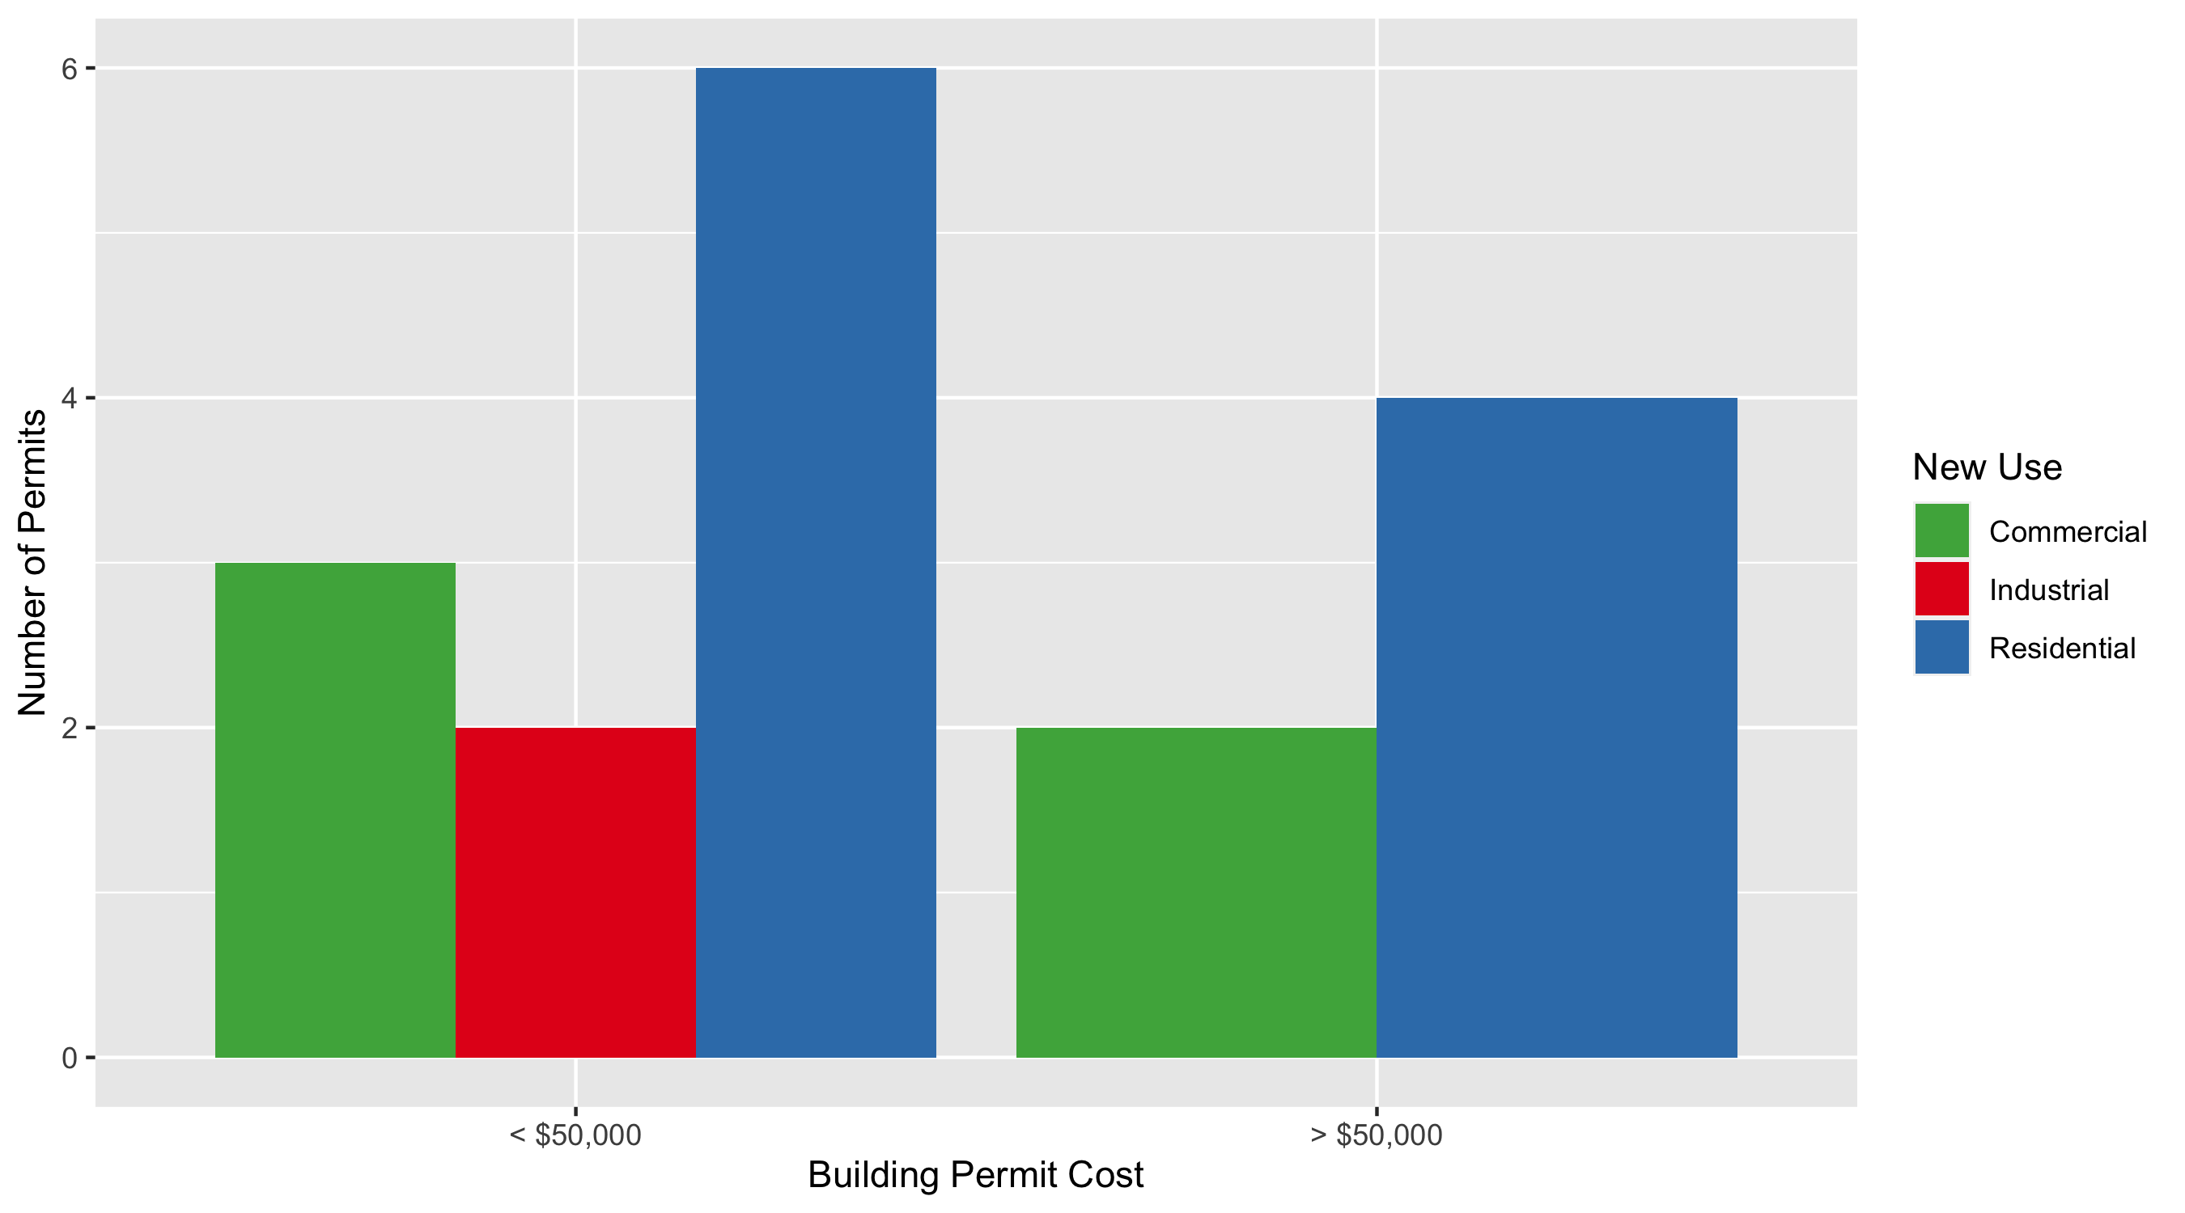
Forest Park Southeast Permit Cost Breakdown

Slide 15
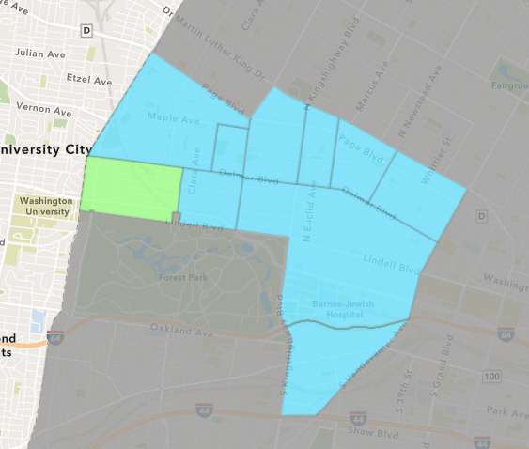
Skinker DeBaliviere
June 2021 Neighborhood Cost Breakdown
Mean: $28,412
Median: $8,547
Range: $4,800 - $145,000

Slide 16
Skinker DeBaliviere: Summary Notes
7 building permits in June 2021
75.00% change compared to June 2020 (4 total building permits)
$28,412: Average building permit cost in June 2021
24.51% change compared to June 2020 ($22,819)
48 total building permits in 2021
-11.11% change YTD compared to this time in 2020 (54 total building permits)
$31,067: YTD average building permit cost in 2021
39.35% change YTD compared to this time in 2020 ($22,295)

Slide 17
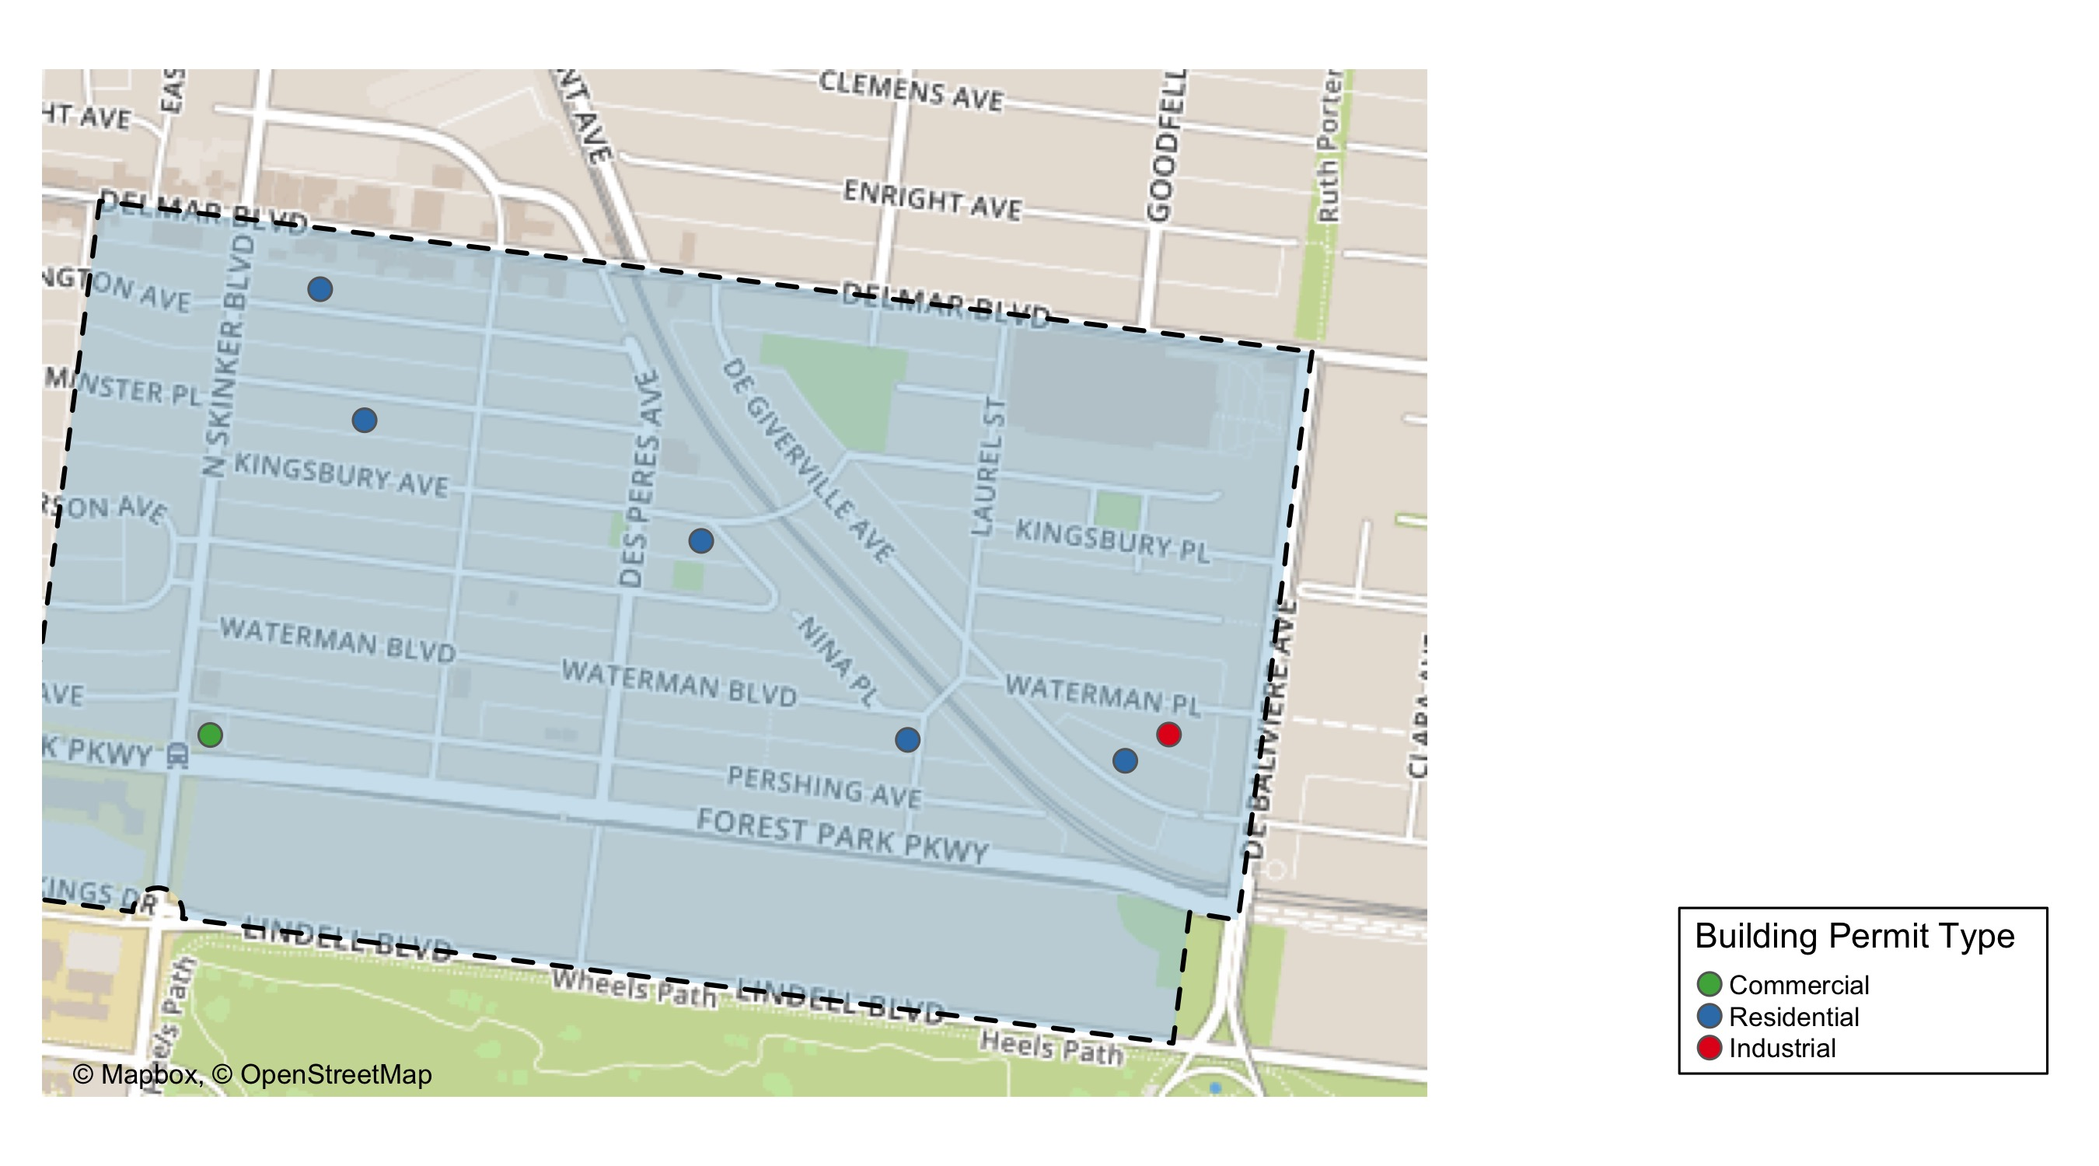
Skinker DeBaliviere

Slide 18
Neighborhood Summary
June 2021 | June 2021 | June 2021 | June 2021
Permit Use | Average Cost | # of Permits | Total Value of Permits
Commercial | $145,000.0 | 1 | $145,000
Industrial | $5,000.0 | 1 | $5,000
Residential | $9,776.8 | 5 | $48,884
Last 6 Months | Last 6 Months | Last 6 Months | Last 6 Months
Permit Use | Average Cost | # of Permits | Total Value of Permits
Commercial | $3,548,663.12 | 17 | $60,327,273
Industrial | $15,978.57 | 7 | $111,850
Residential | $54,671.96 | 140 | $7,654,075

Slide 19
Skinker DeBaliviere Individual Permit Breakdown
nbhd_name | Owner | New Use | Cost | address
Skinker DeBaliviere | ROTHSCHILD, M DAVID III | Residential | $4,800 | 5755 DEGIVERVILLE AV
Skinker DeBaliviere | KIMBRELL, MATTHEW H & | Residential | $8,547 | 6169 WASHINGTON AV
Skinker DeBaliviere | WASHINGTON UNIVERSITY P | Commercial | $145,000 | 282 N SKINKER BLVD
Skinker DeBaliviere | BIERMAN, JANICE O TRS | Residential | $10,956 | 5936 KINGSBURY AV
Skinker DeBaliviere | NODIFF, MARVIN J & LINDA H TRS | Residential | $19,056 | 6142 WESTMINSTER PL
Skinker DeBaliviere | NEEL, VICTORIA NICOLE | Residential | $5,525 | 5802 WATERMAN BLVD
Skinker DeBaliviere | GREEN, CHRISTOPHER & BRIDGETT M | Industrial | $5,000 | 5732 WATERMAN BLVD

Slide 20
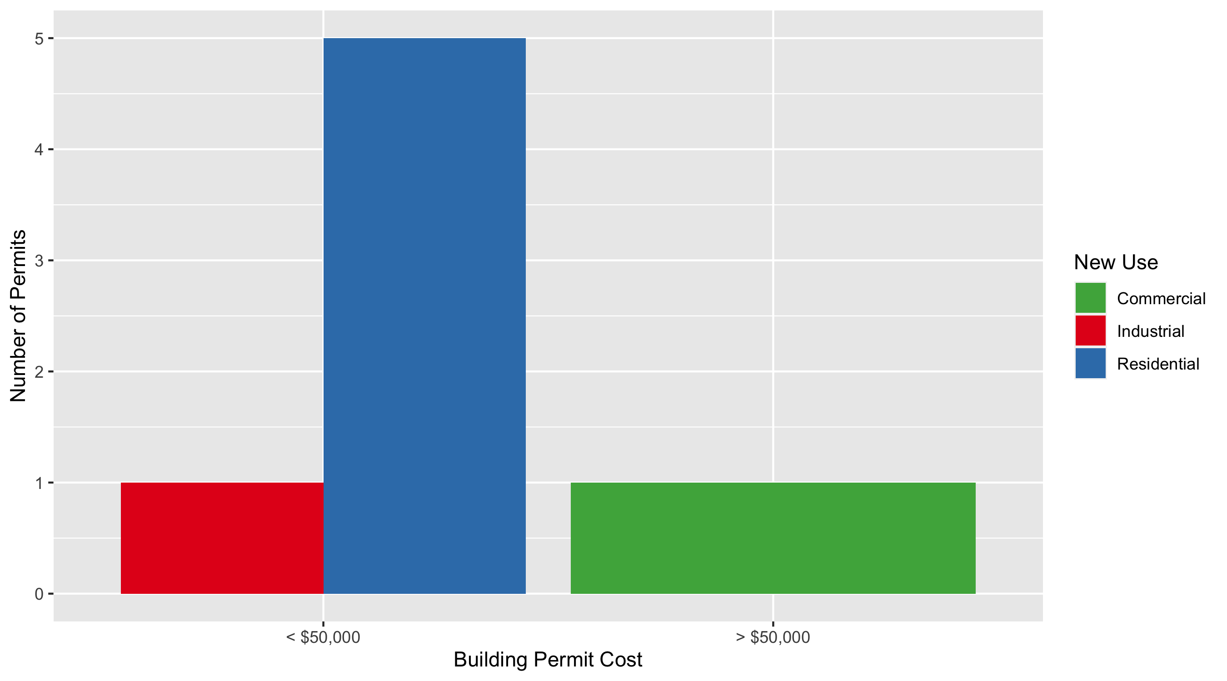
Skinker DeBaliviere Permit Cost Breakdown

Slide 21
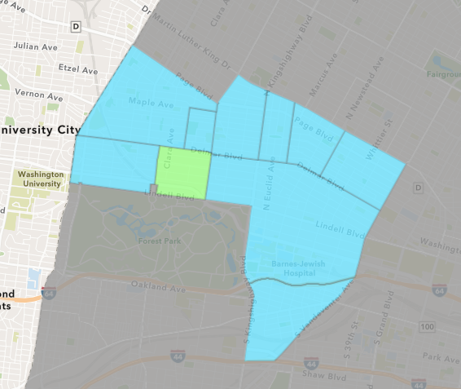
DeBaliviere Place
June 2021 Neighborhood Cost Breakdown
Mean: $20,380
Median: $20,380
Range: $16,000 - $24,760

Slide 22
DeBaliviere Place: Summary Notes
2 building permits in June 2021
-33.33% change compared to June 2020 (3 total building permits)
$20,380: Average building permit cost in June 2021
-78.20% change compared to June 2020 ($93,482)
30 total building permits in 2021
114.29% change YTD compared to this time in 2020 (14 total building permits)
$72,004: YTD average building permit cost in 2021
-70.55% change YTD compared to this time in 2020 ($244,513)

Slide 23
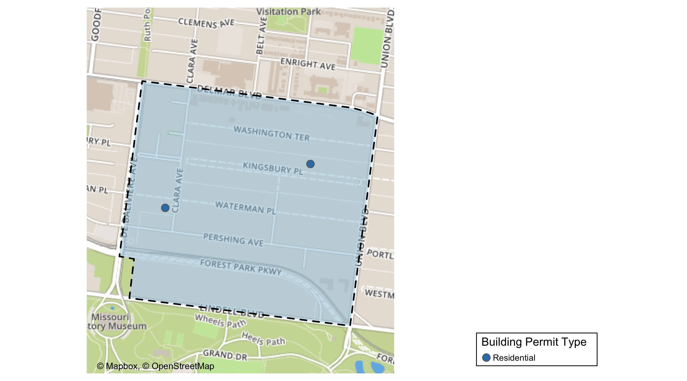
DeBaliviere Place

Slide 24
Neighborhood Summary
June 2021 | June 2021 | June 2021 | June 2021
Permit Use | Average Cost | # of Permits | Total Value of Permits
Commercial | $0 | 0 | $0
Industrial | $0 | 0 | $0
Residential | $20,380 | 2 | $40,760
Last 6 Months | Last 6 Months | Last 6 Months | Last 6 Months
Permit Use | Average Cost | # of Permits | Total Value of Permits
Commercial | $33,466.0 | 6 | $200,796
Industrial | $34,500.0 | 3 | $103,500
Residential | $235,376.2 | 65 | $15,299,453

Slide 25
DeBaliviere Place Individual Permit Breakdown
nbhd_name | Owner | New Use | Cost | address
DeBaliviere Place | WALSMAN, JOSHUA T & | Residential | $16,000 | 323 CLARA AV
DeBaliviere Place | HAMBERG, RONALD P TRS | Residential | $24,760 | 15 KINGSBURY PL

Slide 26
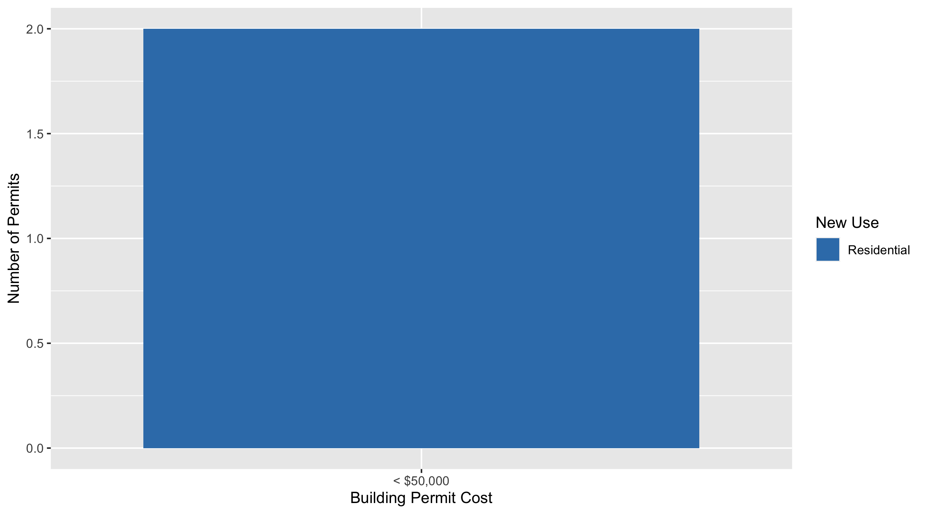
DeBaliviere Place Permit Cost Breakdown

Slide 27
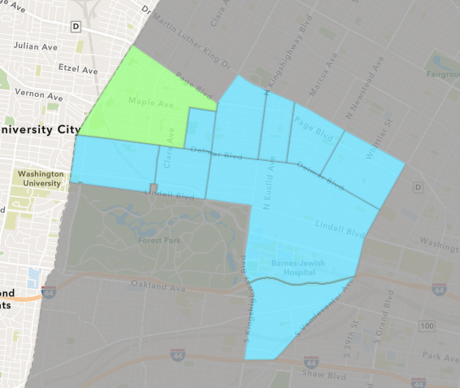
West End
June 2021 Neighborhood Cost Breakdown
Mean: $46,366
Median: $40,000
Range: $800 - $180,000

Slide 28
West End: Summary Notes
25 building permits in June 2021
316.67% change compared to June 2020 (6 total building permits)
$46,366: Average building permit cost in June 2021
-97.52% change compared to June 2020 ($1,872,042)
68 total building permits in 2021
58.14% change YTD compared to this time in 2020 (43 total building permits)
$105,520: YTD average building permit cost in 2021
-73.85% change YTD compared to this time in 2020 ($403,563)

Slide 29
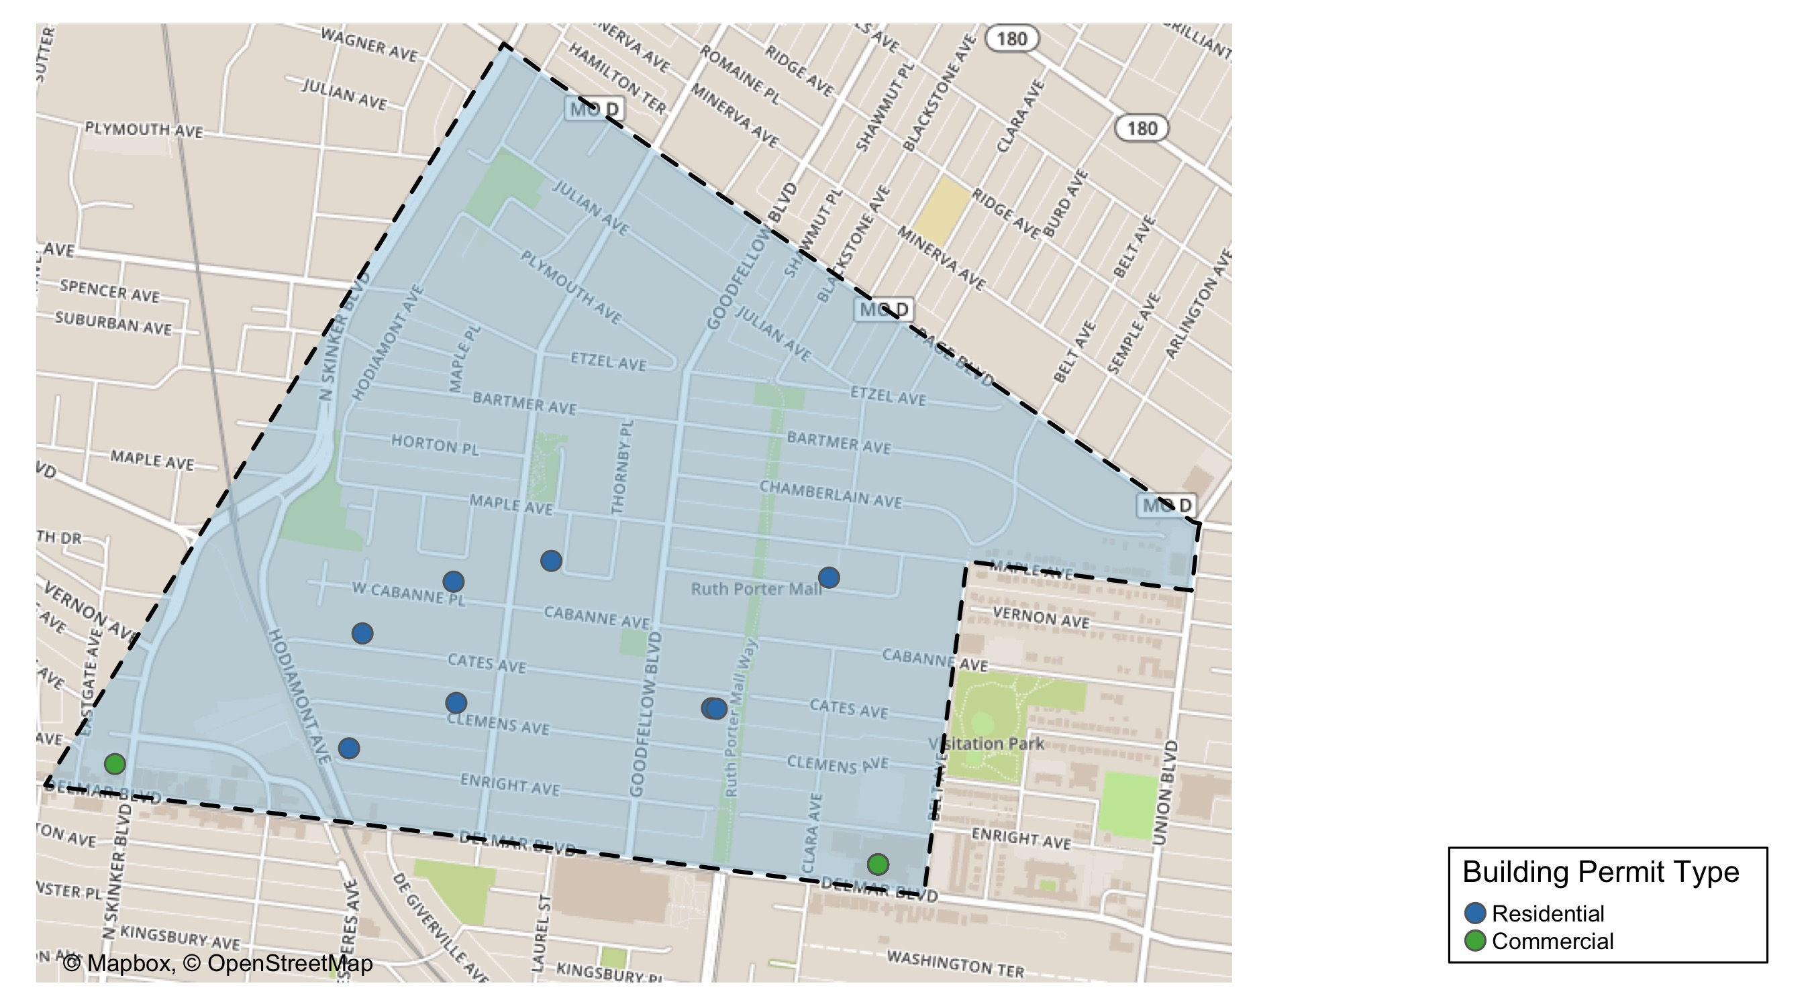
West End

Slide 30
Neighborhood Summary
June 2021 | June 2021 | June 2021 | June 2021
Permit Use | Average Cost | # of Permits | Total Value of Permits
Commercial | $51,384.62 | 13 | $668,000
Industrial | $0.00 | 0 | $0
Residential | $40,929.75 | 12 | $491,157
Last 6 Months | Last 6 Months | Last 6 Months | Last 6 Months
Permit Use | Average Cost | # of Permits | Total Value of Permits
Commercial | $453,434.90 | 30 | $13,603,047
Industrial | $12,058.62 | 13 | $156,762
Residential | $212,184.83 | 110 | $23,340,331

Slide 31
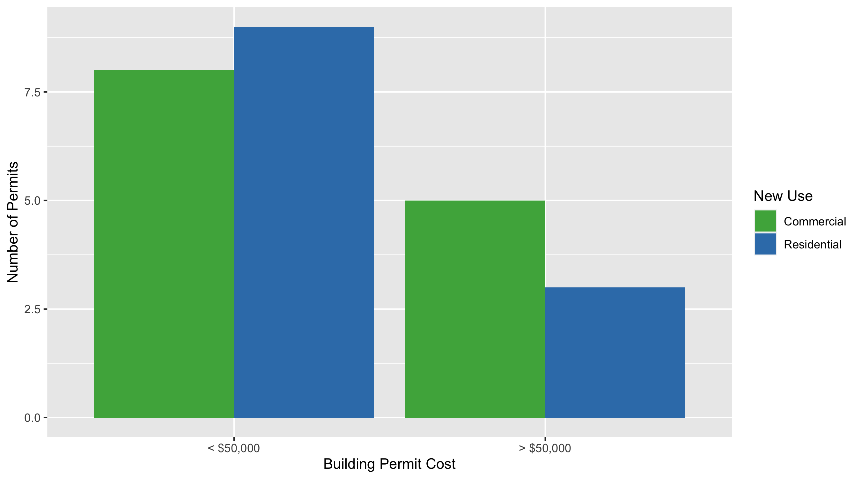
West End Permit Cost Breakdown

Slide 32
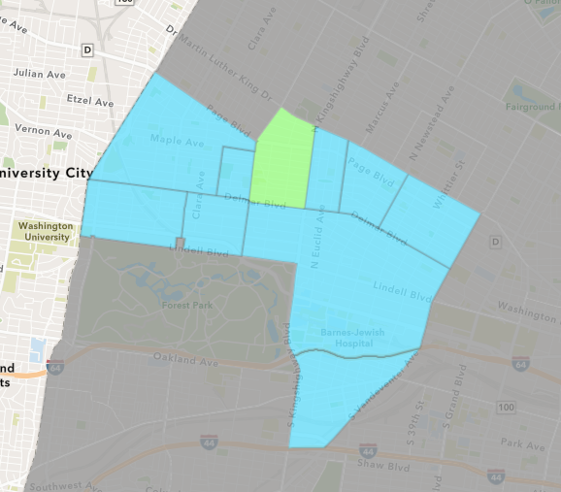
Academy
June 2021 Neighborhood Cost Breakdown
Mean: $1,464
Median: $892
Range: $475 - $3,600

Slide 33
Academy: Summary Notes
4 building permits in June 2021
33.33% change compared to June 2020 (3 total building permits)
$1,464: Average building permit cost in June 2021
-97.18% change compared to June 2020 ($51,917)
14 total building permits in 2021
-6.67% change YTD compared to this time in 2020 (15 total building permits)
$52,954: YTD average building permit cost in 2021
-24.99% change YTD compared to this time in 2020 ($70,593)

Slide 34
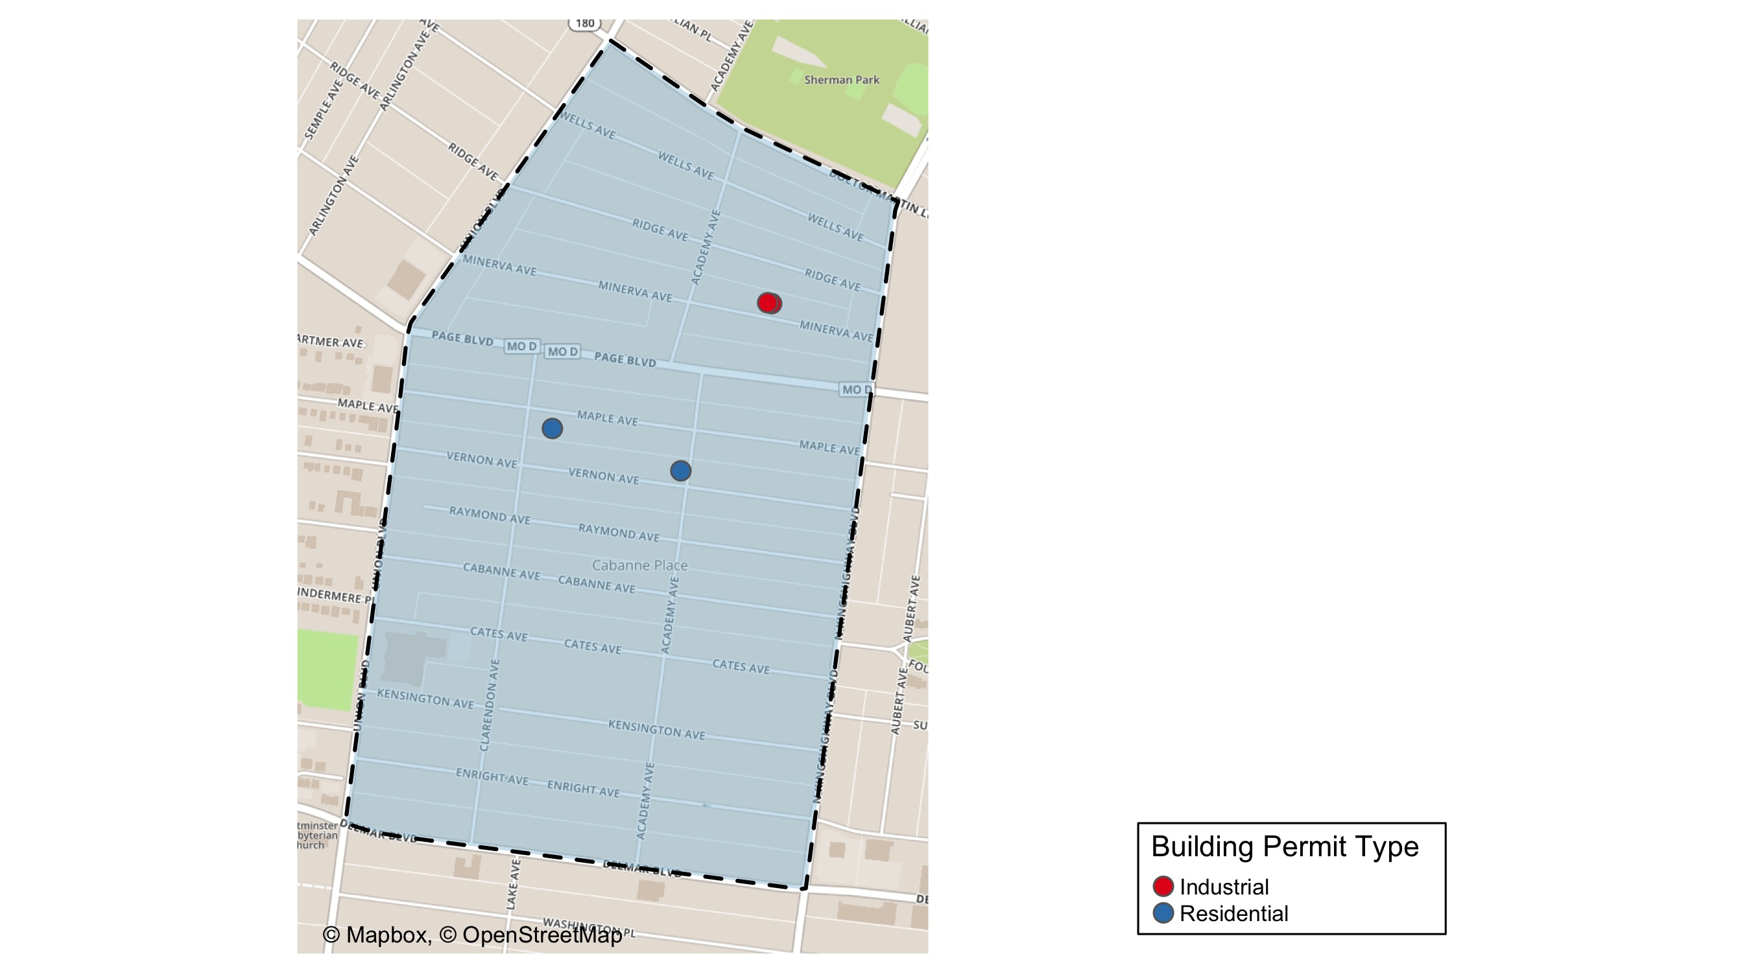
Academy

Slide 35
Neighborhood Summary
June 2021 | June 2021 | June 2021 | June 2021
Permit Use | Average Cost | # of Permits | Total Value of Permits
Commercial | $0 | 0 | $0
Industrial | $475 | 2 | $950
Residential | $2,454 | 2 | $4,908
Last 6 Months | Last 6 Months | Last 6 Months | Last 6 Months
Permit Use | Average Cost | # of Permits | Total Value of Permits
Commercial | $40,166.67 | 3 | $120,500
Industrial | $2,862.50 | 4 | $11,450
Residential | $51,449.84 | 43 | $2,212,343

Slide 36
Academy Individual Permit Breakdown
nbhd_name | Owner | New Use | Cost | address
Academy | REED OWENS, LACONNIE | Residential | $1,308 | 5103 VERNON AV
Academy | JEFFRIES, TAWANDA | Industrial | $475 | 5063 MINERVA AV
Academy | JEFFRIES, TAWANDA | Industrial | $475 | 5065 MINERVA AV
Academy | BURROUGHS, KRISTON & | Residential | $3,600 | 5182 MAPLE AV

Slide 37
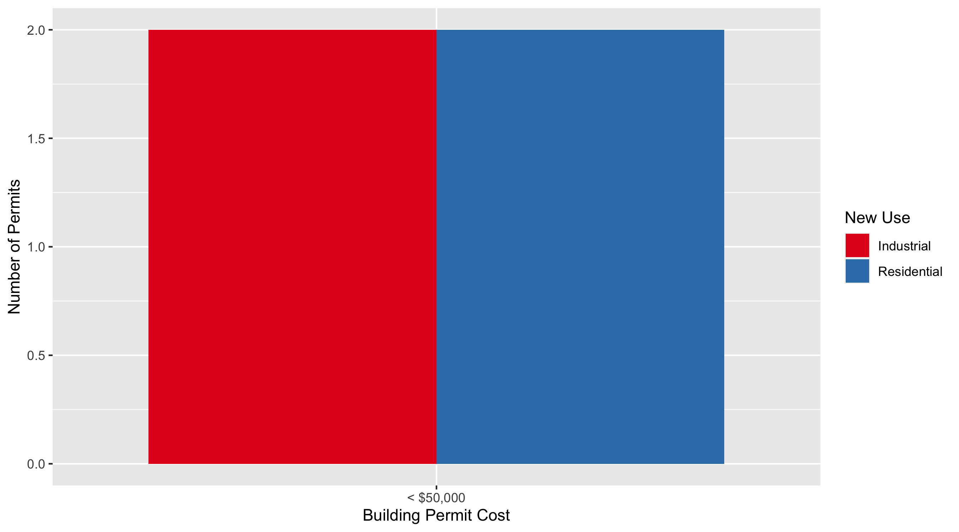
Academy Permit Cost Breakdown

Slide 38
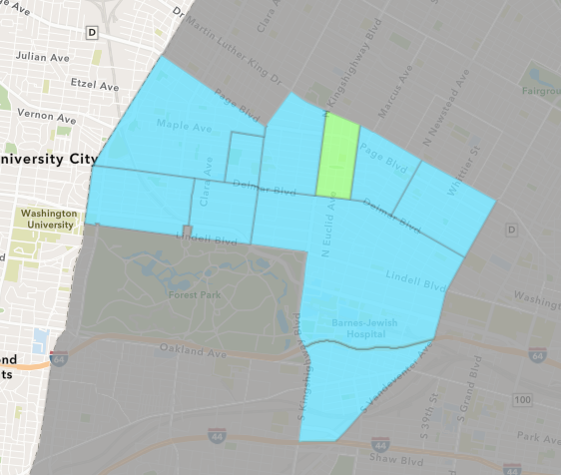
Fountain Park
June 2021 Neighborhood Cost Breakdown
Mean: $710,000
Median: $710,000
Range: $710,000 - $710,000

Slide 39
Fountain Park: Summary Notes
1 building permits in June 2021
0.00% change compared to June 2020 (1 total building permits)
$710,000: Average building permit cost in June 2021
6661.90% change compared to June 2020 ($10,500)
10 total building permits in 2021
233.33% change YTD compared to this time in 2020 (3 total building permits)
$361,752: YTD average building permit cost in 2021
7938.93% change YTD compared to this time in 2020 ($4,500)

Slide 40
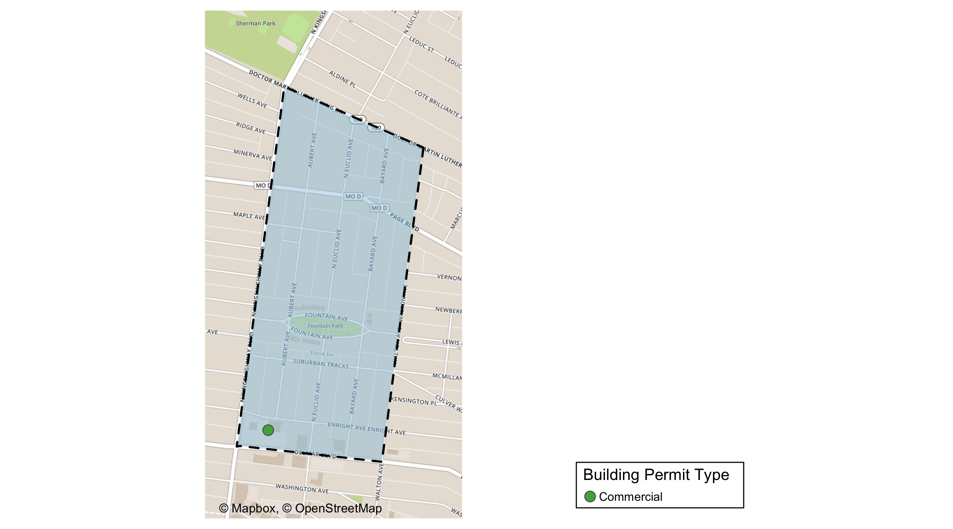
Fountain Park

Slide 41
Neighborhood Summary
June 2021 | June 2021 | June 2021 | June 2021
Permit Use | Average Cost | # of Permits | Total Value of Permits
Commercial | $710,000 | 1 | $710,000
Industrial | $0 | 0 | $0
Residential | $0 | 0 | $0
Last 6 Months | Last 6 Months | Last 6 Months | Last 6 Months
Permit Use | Average Cost | # of Permits | Total Value of Permits
Commercial | $895,754.2 | 4 | $3,583,017
Industrial | $27,500.0 | 2 | $55,000
Residential | $20,800.0 | 10 | $208,000

Slide 42
Fountain Park Individual Permit Breakdown
nbhd_name | Owner | New Use | Cost | address
Fountain Park | ALDI INC | Commercial | $710,000 | 702 N KINGSHIGHWAY BLVD

Slide 43
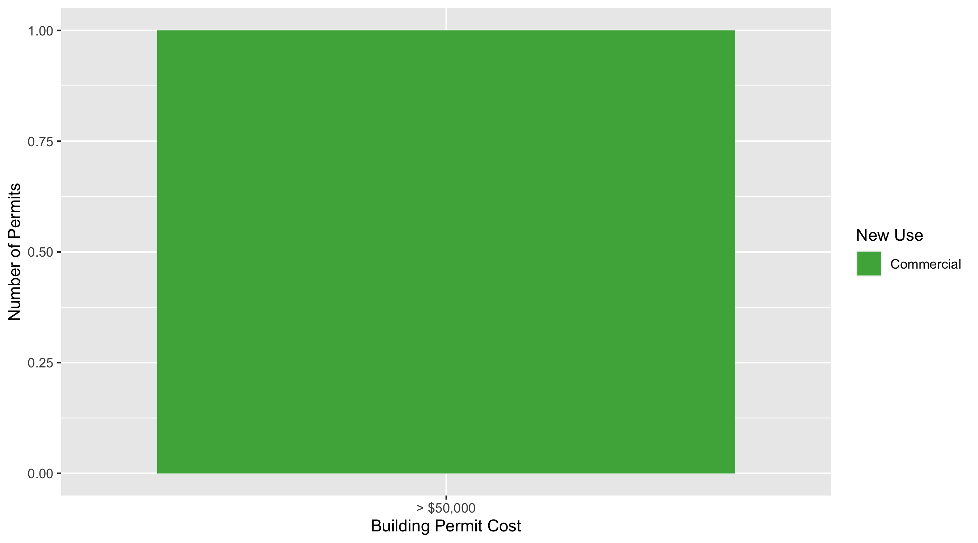
Fountain Park Permit Cost Breakdown

Slide 44
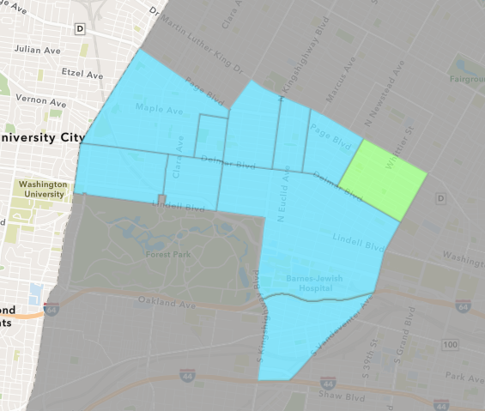
Vandeventer
June 2021 Neighborhood Cost Breakdown
Mean: $10,500
Median: $10,500
Range: $1,000 - $20,000

Slide 45
Vandeventer: Summary Notes
2 building permits in June 2021
-33.33% change compared to June 2020 (3 total building permits)
$10,500: Average building permit cost in June 2021
-83.73% change compared to June 2020 ($64,549)
2 total building permits in 2021
-71.43% change YTD compared to this time in 2020 (7 total building permits)
$10,500: YTD average building permit cost in 2021
-71.95% change YTD compared to this time in 2020 ($37,440)

Slide 46
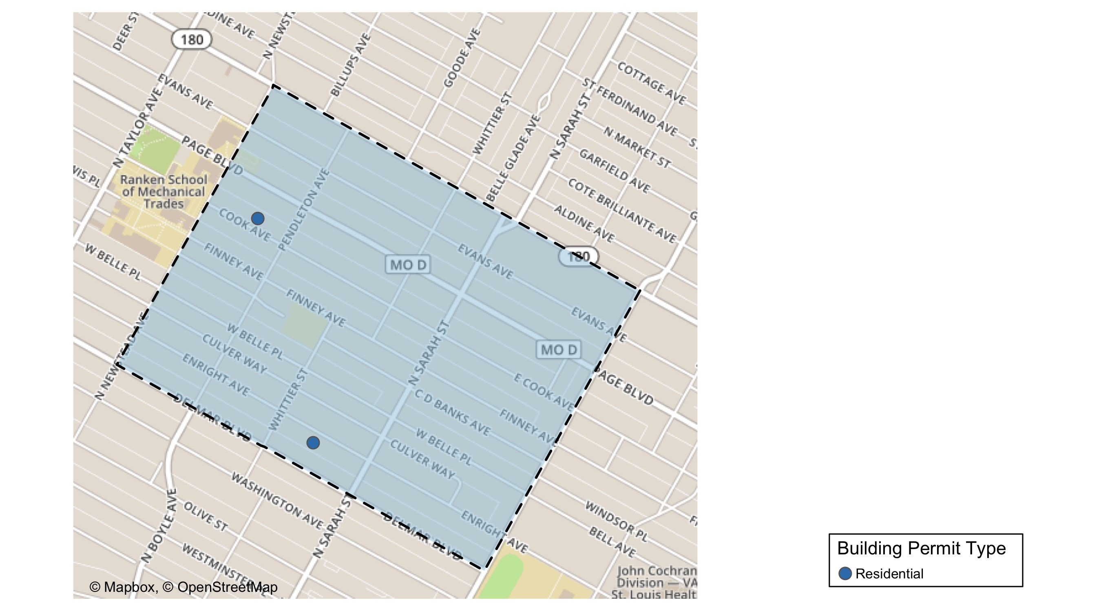
Vandeventer

Slide 47
Neighborhood Summary
June 2021 | June 2021 | June 2021 | June 2021
Permit Use | Average Cost | # of Permits | Total Value of Permits
Commercial | $0 | 0 | $0
Industrial | $0 | 0 | $0
Residential | $10,500 | 2 | $21,000
Last 6 Months | Last 6 Months | Last 6 Months | Last 6 Months
Permit Use | Average Cost | # of Permits | Total Value of Permits
Commercial | $28,223.00 | 3 | $84,669
Industrial | $55,000.00 | 1 | $55,000
Residential | $39,025.33 | 15 | $585,380

Slide 48
Vandeventer Individual Permit Breakdown
nbhd_name | Owner | New Use | Cost | address
Vandeventer | ALLEN, HARVEY | Residential | $20,000 | 4333 COOK AV
Vandeventer | GREEN, CAROL | Residential | $1,000 | 4154 ENRIGHT AV

Slide 49
Vandeventer Permit Cost Breakdown

Slide 50
Additional Notes
Data retreived from https://www.stlouis-mo.gov/data/
Building permits with a cost of $0 were dropped
Building permits that were cancelled were dropped
Infinite change indicates 0 permits in the current or previous time period/comparison month so there was a overall increase or decrease

